Slide 2

Part 2: Running regressions
This Photo by Unknown Author is licensed under CC BY-SA

Slide 3
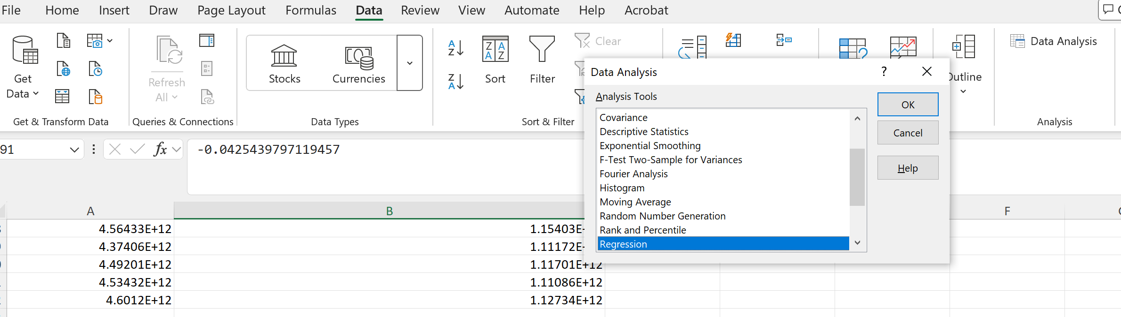
Demo 3: Running Regression Using Excel ToolPak
1
2
3

Slide 4
Preparing the data
NOTE:
The data must be set up in column format :
We do not need the time period but he studied data series must exist in each row
The units of measurement must be the same , example as seen in the example below, the unit is %. You cannot run a regression with a column of data in $ and other series in %.
% labour productivity | growth of capital per employed | Growth of H | Manufacturing, value added (annual % growth)
2.215% | 2.62% | -1.50030899 | 11.92191
3.916% | 10.10% | 1.028610229 | 5.940867
-5.791% | 2.43% | 2.622737885 | -4.18847
-1.443% | 3.83% | 0.32201004 | -4.1503
8.624% | 1.25% | 5.746429443 | 29.67534
3.299% | 3.45% | 0.459590912 | 7.807767
0.473% | 4.51% | 1.747440338 | 0.319107
3.200% | 4.52% | 1.319259644 | 1.671276
1.022% | 1.30% | 1.15071106 | 2.68312
0.165% | -0.82% | 0.888420105 | -5.1278
2.954% | -0.24% | 0.745517731 | 3.701001
4.856% | 5.49% | 1.445590973 | 10.40612
2.768% | -5.58% | 1.528499603 | 7.0287
-1.091% | 0.06% | 1.489292145 | -1.4551
-2.162% | -12.56% | 1.036251068 | 7.530706
11.858% | 25.55% | 3.551319122 | 13.30354
0.796% | 1.35% | 1.249469757 | 2.699762

Slide 5
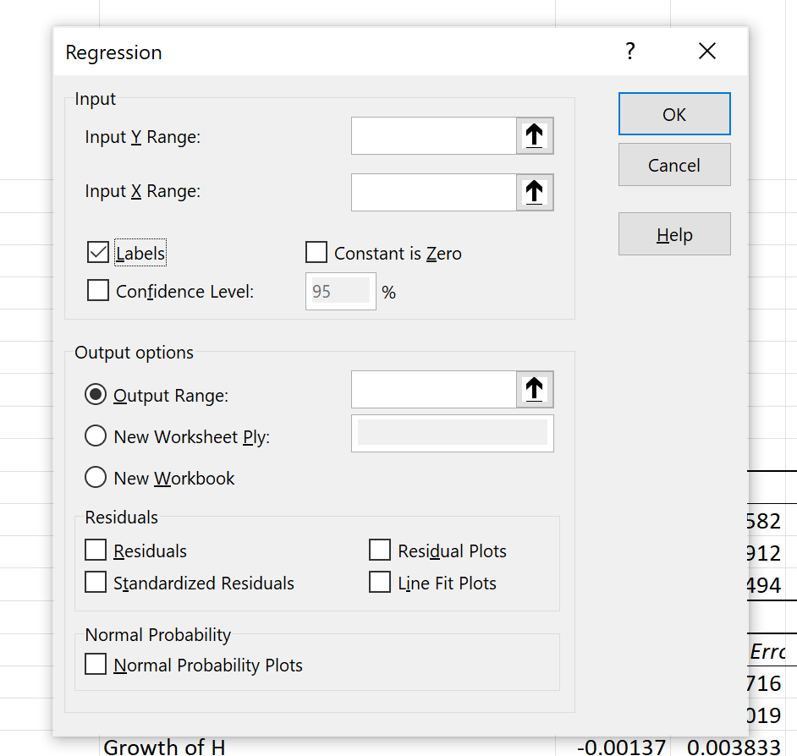
1
% labour productivity | growth of capital per employed | Growth of H | Manufacturing, value added (annual % growth)
2.215% | 2.62% | -1.50030899 | 11.92191
3.916% | 10.10% | 1.028610229 | 5.940867
-5.791% | 2.43% | 2.622737885 | -4.18847
-1.443% | 3.83% | 0.32201004 | -4.1503
8.624% | 1.25% | 5.746429443 | 29.67534
3.299% | 3.45% | 0.459590912 | 7.807767
0.473% | 4.51% | 1.747440338 | 0.319107
3.200% | 4.52% | 1.319259644 | 1.671276
1.022% | 1.30% | 1.15071106 | 2.68312
0.165% | -0.82% | 0.888420105 | -5.1278
2.954% | -0.24% | 0.745517731 | 3.701001
4.856% | 5.49% | 1.445590973 | 10.40612
2.768% | -5.58% | 1.528499603 | 7.0287
-1.091% | 0.06% | 1.489292145 | -1.4551
-2.162% | -12.56% | 1.036251068 | 7.530706
11.858% | 25.55% | 3.551319122 | 13.30354
0.796% | 1.35% | 1.249469757 | 2.699762
1
X range
3
Click on any cell next to your data series

Slide 6
Multiple regression interpretation
Summary of findings
Number of observations
Fit of data : Adjusted R2 >= 0.5 is considered a acceptable fit
Coefficient : examine the sign indicating relationship between x and y
*** p value : <= 0.05 suggesting the value plays a significant role in affecting y
The intercept : ie other variables (not X1, X2 that accounts for the changes in y)
2
1
5
3
4

Slide 7
Modifying the regressions
All the p values of the X_{i} are > 0.05
Increase the time period of study
Adjust the X variables

